Slide 1
SOFTWARE PROCESS MODELS

Slide 2
SOFTWARE DEVELOPMENT PROCESS MODELS
Problem solving loop with basic four activities, i.e., problem analysis, problem definition, technical development and solution integration.
Regardless of the process model chosen, all the four activities coexist simultaneously at some level of detail.
A process model is chosen based upon the:
nature of the project,
application,
methods and tools to be used, and
controls and deliverables that are required.
Notes:
Nature of Project: Complexity, Size, Risk, NEW/Old, New Technology?, Res?/Dev.
Nature of Applications: Business, Engg/Scientific, WEB..

Slide 3
The Linear Models

Slide 4
(1) The waterfall model
It suggests a systematic, sequential approach to s/w development.
Important features
All activities are to be performed in an order and one after the other. The output of one is the input to the other.
Verification and validation is to be performed after the end of each phase.
The inputs & outputs at each phase must be defined (i.e. goal of each group is defined).
Once the outputs of a phase are produced (i.e. phase completed) then these should not be changed as it is input to the other. The certified output of a phase that is released for the next phase is called a baseline.

Slide 5
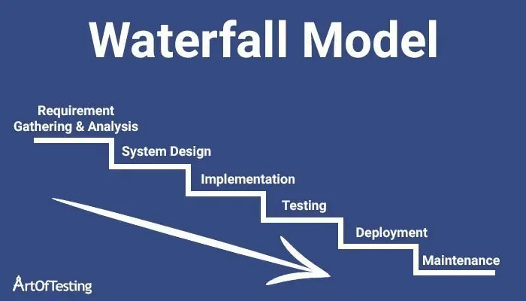

Slide 6
Limitations of Waterfall Model
Limits and freezes the requirements of the system.
Suits to the automation of existing manual system. But having unchanging (or changing few) requirements is unrealistic for new systems.
2. It is often difficult for the customer to state all requirements explicitly. The linear sequential model requires this and has difficulty accommodating the natural uncertainty that exists at the beginning of many projects.
3. Does not support partial system development. This is specially required as client also plays important role in the requirement specification.

Slide 7
(2) Prototyping
This approach is developed to counter the first two limitations of the waterfall model.
A customer may define a set of general objectives for software but does not identify detailed input, processing, or output requirements.
The developer may be unsure of (1) the efficiency of an algorithm, (2) the adaptability of an operating system, or (3) the form the human machine interaction should take.
Instead of freezing the requirements before design, coding can proceed, a throwaway prototype is built to help understand the requirements.

Slide 8
Prototyping…..
This prototype is based on the currently available requirements.
Although the development of prototype also goes through the design and coding phases but main stress is not put on formal procedures.
By using the prototype the user gets the true working environment of the actual system to be designed and developed later on.
Hence more realistic requirement of the required system are brought in.
Typically useful for the areas where a system (manual or automated) does not exist or the overall system is very large and complex.

Slide 9
Requirements Analysis
Design
Code
Design
Code
Test
Test
Disadvantages:
The only drawback seems the duplication of efforts and cost involved in build-twice approach.
Justifications:
Prototyping need not be very costly and can actually reduce the overall development cost.
The prototypes are usually not complete systems and many of the details are not built in.
In addition, cost of testing and writing detail documents is reduced, which reduces the cost of developing prototype.
Further the experience gained during prototyping is very useful for developers when developing the final system. This experience also reduces the cost of development of actual system, and results in more reliable and better design.

Slide 10
Advantages of Prototype Model
Users are actively involved in the development
Since in this methodology a working model of the system is provided, the users get a better understanding of the system being developed.
Errors can be detected much earlier.
Quicker user feedback is available leading to better solutions.
Missing functionality can be identified easily
Confusing or difficult functions can be identified Requirements validation, Quick implementation of, incomplete, but functional, application.

Slide 11
Disadvantages of Prototype Model
If the user is not satisfied by the developed prototype, then a new prototype is developed. This process goes on until a perfect prototype is developed. Thus, this model is time consuming and expensive.
The developer loses focus of the real purpose of prototype and hence, may compromise with the quality of the software. For example, developers may use some inefficient algorithms or inappropriate programming languages while developing the prototype.
Prototyping can lead to false expectations. For example, a situation may be created where the user believes that the development of the system is finished when it is not.
The primary goal of prototyping is speedy development, thus, the system design can suffer as it is developed in series without considering integration of all other components.
Practically, this methodology may increase the complexity of the system as scope of the system may expand beyond original plans.
Incomplete application may cause application not to be used as the full system was designed

Slide 12
Throughway prototype and evolutionary prototype
Throwaway prototype, also known as a mock-up or a rapid prototype, is built to test and validate a specific design concept or idea quickly. It is not meant to be a final product and will not be used in the actual development of the system.
Evolutionary prototype, on the other hand, is built with the intention of gradually evolving it into the final product. It is meant to be refined and improved over time based on feedback and testing.
Throwaway prototype is built quickly and has a short lifespan. It is typically used in the early stages of the development process to quickly validate a design idea or concept.
Evolutionary prototype, on the other hand, is built over a longer period of time and is meant to evolve gradually as more feedback is received.

Slide 13
Throughway prototype and evolutionary prototype
Throwaway prototype is often built with a low level of detail and functionality. It may lack features that will eventually be needed in the final product.
Evolutionary prototype, on the other hand, is built with a higher level of detail and functionality. It may contain some or all of the features that will be included in the final product.
Throwaway prototype is not meant to be used in the actual development of the system. Its purpose is to test and validate a design concept or idea quickly.
Evolutionary prototype, on the other hand, is meant to be refined and improved over time based on feedback and testing. It is used as a basis for the final product, with changes and improvements being made to it until it is ready for release.

Slide 14
(3) RAD Model
Rapid application development (RAD) is a linear sequential S/W development process model that emphasizes on extremely short development cycle.
high-speed RAD is achieved by using a component-based project construction approach.
If requirements are well understood and project scope is constrained (i.e. goals/ are fixed / freezed); the RAD enables a development team to create a “fully functional system” within very short time (e.g. 60-90 days).

Slide 15
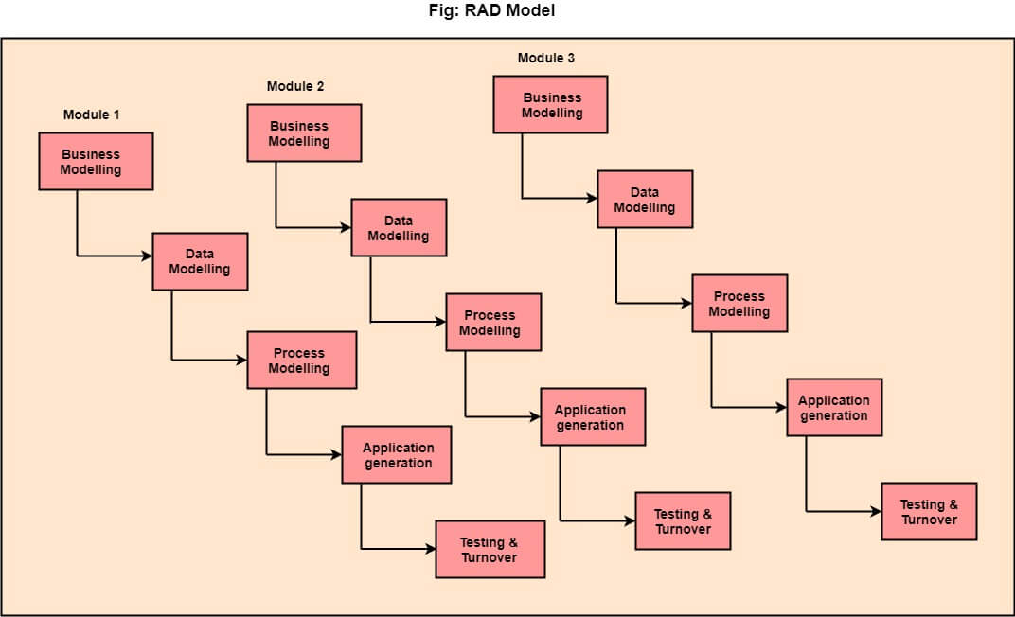

Slide 16
RAD Phases
1. Business Modeling (Business Processes)
Information flows among business functions is modeled such that answers the questions:
What information is generated?
Who generates it?
Who processes it?
Where does the information go?
2. Data Modeling (Entities)
(1) The information flow is refined into a set of data objects that are needed to support the business.
(2) Characteristics (attributes) of each object are identified and
(3) Relationships between these objects are defined.
3. Process modeling (Processes/Functions)
(1) The data object defined in the data modeling phase are transformed to achieve the information flow necessary to implement a business function (i.e. transformation of input-object to output object defines flow of information in a process/function)
(2) Such processing descriptions are created for adding, modifying, deleting, or retrieving a data object.

Slide 17
4. Application Generation
(1) RAD is based on the use of 4GT.
(2) RAD process works to re-use existing components (when possible).
(3) Create re-useable components (when necessary). In all cases automated tools are used to facilitate construction of S/W.
5. Testing and Turnover
(1) Re-use releases from testing, as such components, are already tested.
(2) New components must be tested and all interfaces must be fully exercised. Optimally,
(3) If a business application can be modularized such that each major function can be completed in less than 3 months time, each can be addressed by a separate RAD team, and then integrated (to give working system in 3-6 months)
Notes:
Turnover> Result, yield
large, but scalable?? projects, RAD requires

Slide 18
Drawback
For large scalable projects, RAD requires sufficient human resources to create right number of RAD teams.
RAD requires developers & customers committed to complete a system in a short time frame, other wise if commitment is lacking from either side, RAD projects will fail.
Not all types of applications are appropriate for RAD. If a system cannot be properly modularized, building the components necessary for RAD will be problematic.
RAD is not appropriate when technical risks are high. This occurs when a new application makes heavy use of new technology or when the new software requires a high degree of interoperability with existing computer programs.

Slide 19
EVOLUTIONARY SOFTWARE PROCESS MODELS
There is growing recognition that software, like all complex systems, evolves over a period of time.
Business and product requirements often change as development proceeds.
Software engineers need a process model that has been explicitly designed to accommodate a product that evolves over time.
Evolutionary models are iterative. They are characterized in a manner that enables software engineers to develop increasingly more complete versions of the software.

Slide 20
(5) The Incremental Model
OR Iterative Enhancement Model
1. Solves the problem of 3rd limitation of the waterfall model.
2. Basic idea: software should be developed in increments; each increment adding some functionality until the full system is implemented.
3. At each step, extensions and design modifications can be made .
4. Applies linear sequences in a staggered fashion as time progresses.
Notes:
staggered fashion: Alternating or Overlapping in time period (see next slide);
Design of 1st Inc and Analysis of 2nd and like that

Slide 21
increment 1
Analysis
Design
Code
Test
delivery of 1st increment
increment 2
delivery of 2nd increment
a
n
a
l
y
s
i
s
d
e
s
i
g
n
c
o
d
e
t
e
s
t
increment 3
a
n
a
l
y
s
i
s
d
e
s
i
g
n
c
o
d
e
t
e
s
t
delivery of
3rd increment
increment n
a
n
a
l
y
s
i
s
d
e
s
i
g
n
c
o
d
e
t
e
s
t
delivery of
nth increment

Slide 22
Advantages
Major advantage: it can result in better testing since testing each increment is likely to be easier than testing the entire system.
2. Similar to prototype each increment provides feed back which is useful for determining further/final requirements of the system.
3. Μodel proceeds in steps starting from the simple and key aspects of the system.
4. A project control list is prepared that contains, in order, all the tasks to be implemented in the final system; provides a better control and progress monitoring of development.

Slide 23
Advantages Cont..
Incremental development is particularly useful when staffing is unavailable for a complete implementation by the business deadline that has been established for the project. Early increments can be implemented with fewer people. If the core product is well received, then additional staff (if required) can be added to implement the next increment. In addition, increments can be planned to manage technical risks. For example, a major system might require the availability of new hardware that is under development and whose delivery date is uncertain. It might be possible to plan early increments in a way that avoids the use of this hardware, thereby enabling partial functionality to be delivered to end-users without inordinate delay.

Slide 24
Disadvantages
Needs good planning and design.
Needs a clear and complete definition of the whole system before it can be broken down and built incrementally.
Total cost is higher than waterfall.

Slide 25
Spiral Model
The spiral model, originally proposed by Boehm [BOE88], is an evolutionary software process model that couples the iterative nature of prototyping with the controlled and systematic aspects of the linear sequential model.
It provides the potential for rapid development of incremental versions of the software.
Using the spiral model, software is developed in a series of incremental releases.
During early iterations, the incremental release might be a paper model or prototype. During later iterations, increasingly more complete versions of the engineered system are produced.

Slide 26
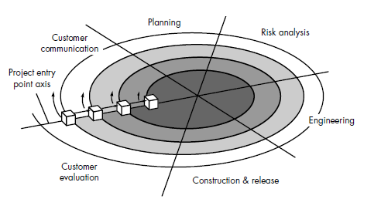
Spiral Model

Slide 27
Spiral Model phase
Customer communication—tasks required to establish effective communication between developer and customer.
Planning—tasks required to define resources, timelines, and other project related information.
Risk analysis—tasks required to assess both technical and management risks.
Engineering—tasks required to build one or more representations of the application.
Construction and release—tasks required to construct, test, install, and provide user support (e.g., documentation and training).
Customer evaluation—tasks required to obtain customer feedback based on evaluation of the software representations created during the engineering stage and implemented during the installation stage.

Slide 28
Cont.
As this evolutionary process begins, the software engineering team moves around the spiral in a clockwise direction, beginning at the center. The first circuit around the spiral might result in the development of a product specification; subsequent passes around the spiral might be used to develop a prototype and then progressively more sophisticated versions of the software.

Slide 29
When to Use Spiral model?
Spiral model is used in the following scenarios:
When the project is large.
Where the software needs continuous risk evaluation.
Requirements are a bit complicated and require continuous clarification.
Software requires significant changes.
Where enough time-frame is there to get end user feedback.
Where releases are required to be frequent.

Slide 30
Advantages of using Spiral Model
Advantages of using Spiral model are as follows:
Development is fast
Larger projects / software are created and handled in a strategic way
Risk evaluation is proper.
Control towards all the phases of development.
More and more features are added in a systematic way.
Software is produced early.
Has room for customer feedback and the changes are implemented faster.

Slide 31
Disadvantages of using Spiral model
Disadvantages of Spiral model are as follows:
Risk analysis is important phase so requires expert people.
Is not beneficial for smaller projects.
Spiral may go infinitely.
Documentation is more as it has intermediate phases.
It is costly for smaller projects

Slide 32
(7) The Component Assembly Model
Object technology provides the technical framework for component-based process model for SE.
The OO paradigm is based on the creation of classes that encapsulate both data and algorithms.
If properly designed and implemented, OO classes are re-useable across different applications and computer architecture.
Resembles and incorporates many of characteristics of spiral model.
It is iterative, but composes application from components/pre-packed S/W (sometimes called “classes”).

Slide 33
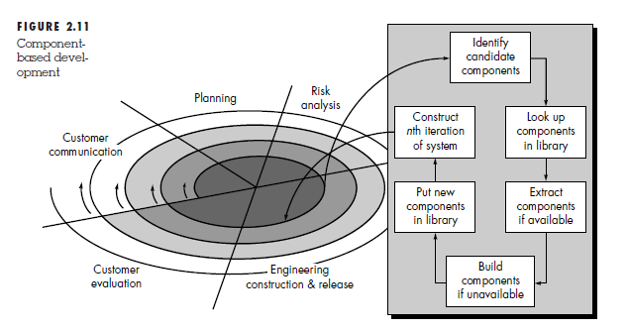

Slide 34
Further
a) Identification of candidate classes is accomplished by examining the data (in the analysis phase) that are to be manipulated and the operations (algorithms) required.
b) Class library is also called component repository. A component if found in library may require tailoring/modification to fulfill the (new) requirements of the application.
c) According to a survey, component assembly leads to a 70% reduction in development cycle time, an 84% reduction in project cost.

